Slide 1

What is Robot?
A robot is a machine that can do tasks by itself, often with help from a computer or a program.

Slide 2
What is Robot?
A robot is a machine made to help people.
It can move, sense things, and sometimes think or decide what to do.
Robots can be controlled by a person or by a program.
Notes:
Sun -> Milky Way -> Local Group (30 Galaxy) -> Laniakea Supercluster (Local Supercluster)

Slide 3
What Makes Up a Robot?
Main Parts of a Robot:
Controller/Brain: Like a mini-computer that tells the robot what to do.
Sensors: Help the robot see, hear, or feel what's around it.
Motors and Actuators: Make the robot move.
Power Source: Usually batteries to give the robot energy.
Body/Frame: The structure that holds all the parts together.
Notes:
Sun -> Milky Way -> Local Group (30 Galaxy) -> Laniakea Supercluster (Local Supercluster)

Slide 4
What is Electricity?
Electricity is the flow of tiny particles called electrons that power machines like robots.
It flows through wires and powers machines, lights, and electronics.
Key Points:
Electricity = Moving energy.
It flows like water in a pipe.
Needs a path (wire) and a power source (like a battery).
Notes:
Sun -> Milky Way -> Local Group (30 Galaxy) -> Laniakea Supercluster (Local Supercluster)

Slide 5
What is Current?
Current is the flow of electricity through a wire.
Current is how much electricity is flowing
It’s like how much water flows in a pipe every second.
It tells us how many electrons are moving in a wire.
Key Points:
Current = Flow of electric energy.
Measured in Amperes (Amps).
More current means more power is flowing.
Without current, nothing gets powered.
Notes:
Sun -> Milky Way -> Local Group (30 Galaxy) -> Laniakea Supercluster (Local Supercluster)

Slide 6
What is Voltage?
Voltage is the pressure or push that moves electricity through the wire.
It’s like water pressure in a hose – higher pressure means stronger push.
Key Points:
Voltage = Push behind the current.
Measured in Volts (V).
More voltage = stronger push.
No voltage = no flow.
Without voltage, current can’t move — and electricity won’t work.
Notes:
Sun -> Milky Way -> Local Group (30 Galaxy) -> Laniakea Supercluster (Local Supercluster)

Slide 7
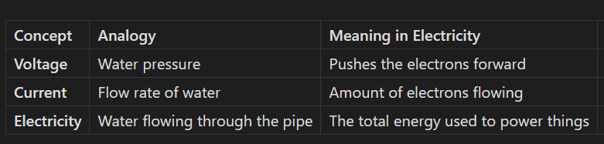
Relationship among Electricity, Current, and Voltage
Think of electricity like water flowing through a pipe.
Notes:
Sun -> Milky Way -> Local Group (30 Galaxy) -> Laniakea Supercluster (Local Supercluster)

Slide 8
Electronic Components or Electronic Parts
Input Components / Sensors
Light Sensor (LDR)
Sound Sensor
Touch Sensor
Temperature Sensor
Water Sensor
Ultrasonic Sensor
PIR Motion Sens
Output Components
LED
RGB LED
Buzzer
Notes:
Sun -> Milky Way -> Local Group (30 Galaxy) -> Laniakea Supercluster (Local Supercluster)

Slide 9
Electronic Components or Electronic Parts
Actuators / Motion Components
Servo Motor
DC Motor
Control / Processing Modules
Microcontroller
Connection Components
Jumper Wires
Crocodile Clips
Notes:
Sun -> Milky Way -> Local Group (30 Galaxy) -> Laniakea Supercluster (Local Supercluster)

Slide 10
Electronic Components – Made Easy!
Every electronic project or device usually has three important wires:
1. Power Wire (VCC or +)
This wire gives power to the electronic part.
It’s usually red in color.
Think of it like the "on" switch — it sends energy to make things work.
Connect this wire to the 3V pin on the micro:bit. This pin provides a 3-volt output suitable for low-power components
Notes:
Sun -> Milky Way -> Local Group (30 Galaxy) -> Laniakea Supercluster (Local Supercluster)

Slide 11
Electronic Components – Made Easy!
Every electronic project or device usually has three important wires:
2. Ground Wire (GND or –)
This wire completes the circuit and takes unused power away.
It’s usually black or brown.
Think of it like the return path for electricity.
Attach this wire to one of the GND pins on the micro:bit. Establishing a common ground is essential for the circuit's proper operation. ​
Notes:
Sun -> Milky Way -> Local Group (30 Galaxy) -> Laniakea Supercluster (Local Supercluster)

Slide 12
Electronic Components – Made Easy!
Every electronic project or device usually has three important wires:
3. Signal Wire (PWM or Control Wire)
This wire sends signals or instructions to parts like LEDs, motors, or buzzers.
It’s usually white, yellow, or orange.
It tells things how fast, how bright, or when to turn on or off.
Connect this wire to one of the micro:bit's General Purpose Input/Output (GPIO) pins.
Common choices include pins P0, P1, and P2, which support both digital and analog (PWM) signals.
Notes:
Sun -> Milky Way -> Local Group (30 Galaxy) -> Laniakea Supercluster (Local Supercluster)

Slide 13
Types of Signals
There are two types of Signals:
1. Digital Signal
This is like a simple YES or NO.
It’s either ON (1) or OFF (0).
Example: An LED that is either on or off.
Notes:
Sun -> Milky Way -> Local Group (30 Galaxy) -> Laniakea Supercluster (Local Supercluster)

Slide 14
Types of Signals
There are two types of Signals:
1. Analog Signal
This can be any value in between.
Like how loud, how bright, or how fast something should be.
BBC micro:bit, the analog-to-digital converter (ADC) is 10-bit, meaning it produces values from 0 to 1023, corresponding to an input voltage range of 0 to 3 volts..
Example: 0 = no brightness
1023 = full brightness
1 volt ≈ 341
Notes:
Sun -> Milky Way -> Local Group (30 Galaxy) -> Laniakea Supercluster (Local Supercluster)

Slide 15
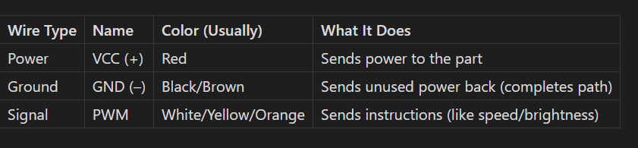
Summary Table
Notes:
Sun -> Milky Way -> Local Group (30 Galaxy) -> Laniakea Supercluster (Local Supercluster)

Slide 16
What is an ADC?
An Analog-to-Digital Converter (ADC) is a component that converts an analog voltage (a continuous value like 1.23 volts) into a digital number that a microcontroller (like the one in the BBC micro:bit) can understand and process.
Notes:
Sun -> Milky Way -> Local Group (30 Galaxy) -> Laniakea Supercluster (Local Supercluster)

Slide 17
What does “10-bit” ADC mean?
The term “10-bit” refers to the resolution of the ADC.
A 10-bit ADC can represent analog values using 2¹⁰ = 1024 discrete steps.
These steps range from 0 to 1023.
So, instead of saying "the voltage is 1.23V," the micro:bit will say something like "the analog reading is 420," which you can convert back to volts.
Notes:
Sun -> Milky Way -> Local Group (30 Galaxy) -> Laniakea Supercluster (Local Supercluster)

Slide 18
Voltage Range of the BBC micro:bit
The BBC micro:bit's ADC can read voltages from 0 to 3.0 volts.
This means:-
0 volts corresponds to an ADC value of 0.
3 volts corresponds to the maximum ADC value of 1023.
Any voltage between 0 and 3 volts will be converted to a value between 0 and 1023.
Notes:
Sun -> Milky Way -> Local Group (30 Galaxy) -> Laniakea Supercluster (Local Supercluster)

Slide 19

How does this mapping work?
The ADC divides the voltage range (0 to 3 volts) into 1024 equal parts (steps). Each step represents a voltage difference of:
So:
1 step ≈ 0.00293V
100 steps ≈ 0.293V
341 steps ≈ 1.0V
Notes:
Sun -> Milky Way -> Local Group (30 Galaxy) -> Laniakea Supercluster (Local Supercluster)

Slide 20
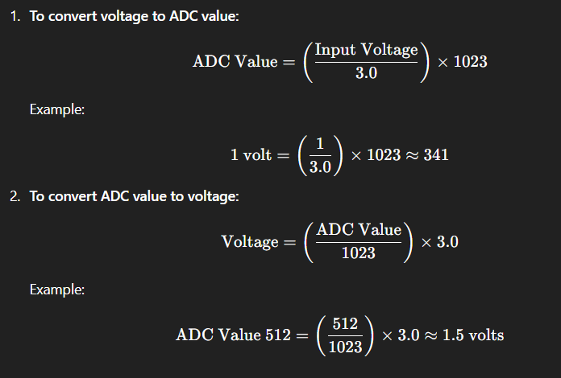
Example Calculations
Notes:
Sun -> Milky Way -> Local Group (30 Galaxy) -> Laniakea Supercluster (Local Supercluster)

